Slide 1

Cross cultural communication
Week 1, Fall 2017
Gloria Walker, ABC, FRSA

Slide 2
Before We Begin -
https://www.surveymonkey.co.uk/r/3VSB3VX

Slide 3





Slide 4
Course Objectives
Facilitate understanding of the competencies required to overcome barriers to cross-cultural communication
Develop in students the capacity to communicate appropriately and effectively in diverse cultural contexts.
Topics and discussion areas include . . .
Cultural awareness and cultural identity
Communication and communication competence
Managing conflict across cultures
Cross-cultural communication in the workplace
Cross-cultural communication in business situations

Slide 5
Course Requirements
“My Culture” photo essay 20%
Book or film review 20%
Cross-cultural business practices report 30%
(working in pairs)
Final exam 20%
Participation 10%
Total 100%

Slide 6
Course Schedule
Week 1 – Sept 11, 13
Culture, communication and business
Reading: Quappe and Cantatore
Week 2 – Sept 18, 20
Personality, cultural identity, cultural representations
Reading: Hooker
Week 3 – Sept 25, 27
Cultural theories – Hall and Hofstede; national cultures and cultural clusters
Reading: Hall’s Iceberg Model
Week 4 – Oct 2, 4
Cultural theories – Trompenaars and Hampden-Turner, Meyer
A1 “My Culture” photo essay due

Slide 7
Week 5 – Oct 9, 11
Cultural representations; cross cultural differences in communication styles
Reading: Acosta
Week 6 – Oct 16, 18
Communicating interculturally; improving intercultural communication skills
Reading: Liu et al
Week 7 – Oct 23, 25
Communication and cultural competence; ethnocentrism and ethnorelativism
Readings: Wang; Bennett
Week 8 – Oct 30, Nov 1
Other cultural influences – gender, religion, age, and other issues
Culture and business – negotiation, conflict and feedback
Reading: Cuddy et al
A2 book or film review due

Slide 8
Week 9 – Nov 6, 8
Organizational culture, models and actual organizations
Reading: Hofstede
Week 10 – Nov 13, 15
Business practices; cultural and international marketing
Reading: Passport to Trade 2.0; Dahlvig; Tian & Boyes
Week 11 – Nov 20, 22
Reading Week – no classes
Readings: Harvard Business Review; Lau
Week 12 – Nov 27, 29
Group dynamics; individual and group identities
Effective teams; team diversity
A3 reports due

Slide 9
Week 13 – Dec 4, 6
Stakeholders and cultural intermediaries
Leadership and culture
Week 14 – Dec, 11, 13
Reputation and cultural issues
Cultural intelligence and intercultural effectiveness
Wrap-up and exam review
A5 Participation completed
Week 15 – Dec 18 – 21 (specific date to be confirmed)
A4 Final examination

Slide 10
Rule 1
Come to class.
Miss too many meetings in the real world and you get fired.
If you miss class, you are responsible for catching up on what you have missed.
UKBA keep track of class attendance for visas.
Contributes significantly to participation grade.

Slide 11
Rule 2
Be on time and ready.
Always late for meetings? You put yourself on the road to getting fired.
Bring pen and paper and a readiness to participate.
Do any preparation work.
Hult policy states that after 5 minutes late, you will be marked as Absent, Unexcused.

Slide 12
Rule 3
No laptops, tablets or phones out unless you are given permission.

Slide 13
Rule 4
Respect Deadlines.
In business, if you don’t meet deadlines, you get in trouble.
Inform the Registrar of illness and/or emergencies so your absences are excused.
If assignments are late, you lose letter grades.
But - much better to submit late than not to submit at all.
If you have problems, let me and the Registry know EARLY.

Slide 14
Rule 5
Respect your colleagues.
Learn to listen; if you can’t listen, at least be quiet.
Don’t distract with your devices. First/mild offences will bring a warning.
Continue or really disrespect the class and you will be asked to leave.
Keep an open mind.

Slide 15
Simple Rules
1. Come to class
2. Be on time and ready
3. No laptops, tablets, phones
4. Respect your colleagues
5. Respect deadlines

Slide 16
Introductions
Who am I?
Strategic communications consultant; now an academic
Worked in many kinds of organisations
Worked in US, Europe and Asia
Taught at universities in UK, US and Thailand

Slide 17
Who Are You?
Work in pairs
Find out about each other
Where from
Career ambitions
One interesting fact
Introduce your colleague to the class

Slide 18
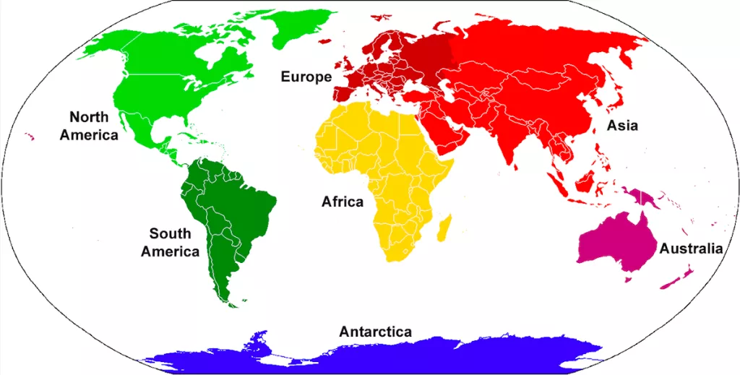
Learning about our class
Live demographics exercise
Age
Gender
Continent
Country
Likes/dislikes
Etc

Slide 19
Cross Cultural Communication
Culture, communication, business
Worksheet 1

Slide 20
What is Cultural awareness? Quappe and Cantatore
1. Why is cultural awareness important?
2. Are stereotypes accurate?
3. What are the levels of cultural awareness?
4. What is meant by cultural contingency?
5. How can you manage cultural diversity?

Slide 21
Cross cultural communication
What is culture?
What is communication?
What is business?
Is cultural awareness important for business in the 21st century?
Why?

Slide 22
In small groups, discuss ---
What perception of London did you have before you arrived?
Did you or do you feel culture shock while experiencing life in London?
Here at Hult?

Slide 23
What is culture?

Slide 24
Some quotes
“Much of what matters in our lives – like our cultural heritage and our institutions, for example – are mere creations of human imagination.”
Leo Mannheimer in the Girl Who Takes an Eye for an Eye, David Lagencrantz (2017)
“Culture eats strategy for breakfast.”
Peter Drucker and others

Slide 25

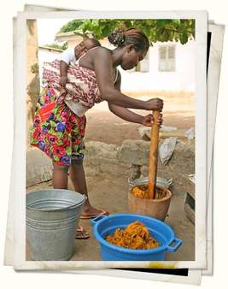
What is culture?
In the narrow sense:
“civilisation” (art, science, education)
In the broad anthropological sense:
“collective programming of the human mind”
process of socialization

Slide 26


Culture influences everyone
Heredity and experience at three levels
PERSONAL CULTURE
TRANSITIONAL CULTURE
Collective by group
Common to all mankind
DEEP CULTURE

Slide 27
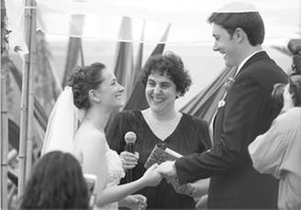
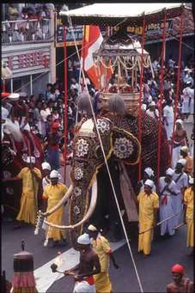
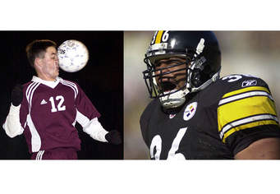
Culture affects
The way we live
The way we die
The way we organise
The way we perceive
The way we do business
The way we communicate

Slide 28
We need to belong!
Belonging is part of human nature
Meets our need for self-actualization
Culture helps to define us
We move in and out of cultures every day
How many cultures are you a part of?

Slide 29

Levels of cultural diversity
Gender level
Generation level
National level
Affiliation levels (and/or)
Regional, ethnic, religious, linguistic
Social Class
Education, occupation or profession
Organisational or corporate level
Work out your diversity profile!

Slide 30
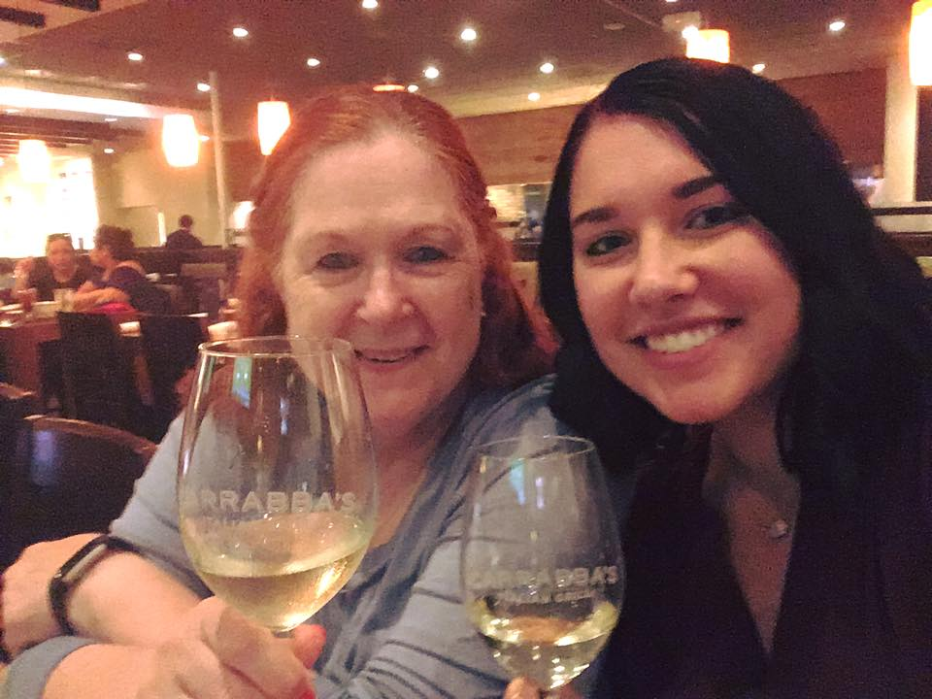
My cultural diversity
Gender - Female
Generation - Baby Boomer
National - American
Affiliation –
Caucasian
Episcopalian
Mother of two children
Family and friends in US, UK, Europe, Asia
Gamma Phi Beta sorority
Junior League of London
Social class –
WVU and UT alum
Consultant
Self-employed
Part-time lecturer
IABC, EUPRERA, CIPR, ICA, IoIC, RSA
Organizational or corporate –
Hult International Business School
London College of Communication

Slide 31
Benefits of cultural awareness
Healthier communities
Increased commerce
Reduced conflict
Personal growth through tolerance

Slide 32
For discussion
https://www.youtube.com/watch?v=8Ox5LhIJSBE

Slide 33
What is communication?

Slide 34
Types of communication
Interpersonal – 1 to 1
Semi-formal – 1 to some
Formal – 1 to many
Mass – 1 to thousands, even millions
Each uses different media
Each requires different skills
All are influenced by culture

Slide 35


Four Elements
Message
Feedback
Receiver
Sender

Slide 36
Four Elements
Message
Barriers
Feedback
Receiver
Sender

Slide 37

Barriers to Communication
Physical separation
Status differences
Gender differences
Cultural diversity
Language
Communication Barriers -
factors that block or significantly distort successful communication
Notes:
12
23
23

Slide 38
What is business?

Slide 39
What is the purpose of business?

Slide 40
What is the purpose of business?
“The incentive of business is not to produce goods but to make money.”
Thorsen Veblen, 1923
Get and keep customers
Products and services customers want
Deliver on brand promise
Theodore Levitt, 1983
“Give your brands a social purpose”
“Make a difference”
Paul Polman, Unilever, 2014

Slide 41


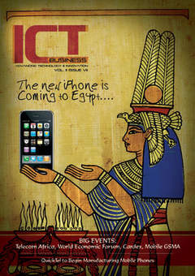

Key issues for business
Leadership and listening
Priorities and conflicts
Processes and systems
In person and at a distance
Digital technology as a support
Honesty and trust
Consistency and persistence
Reputation and engagement

Slide 42
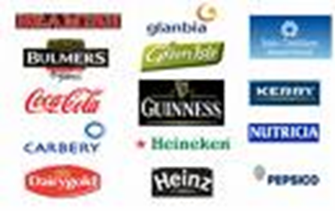



And one more - brand
Direction as an organisation
Priorities
Core competences
Alliances
Value proposition
Stakeholders
Culture
Communications influences brand perceptions!

Slide 43
Why are culture and communication important for business?

Slide 44
Reputation
What is it?
How is it created?
Does it really matter?

Slide 45
Reputation
It's the result of what you do, what you say, and what others say about you.
It is used to gain trust and understanding between an organization and its various stakeholders.

Slide 46



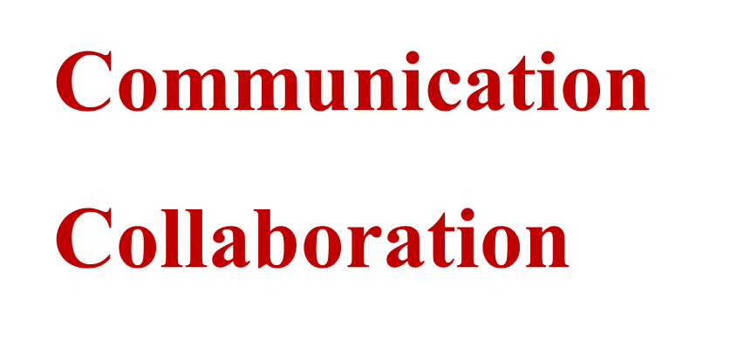
Interrelationships are affected by culture.

Slide 47
Degrees of Cultural Awareness (Quappe and Cantatore, 2005)
My way is the only way (Parochial stage)
I know their way, but my way is better (Ethnocentric stage)
My Way and Their Way (Synergistic stage)
Our Way (Participatory Third Culture stage)
Exercise – Assessing your ethnocentrism

Slide 48
For Wednesday
Personality
Cultural identity
Cultural representations

